Slide 1

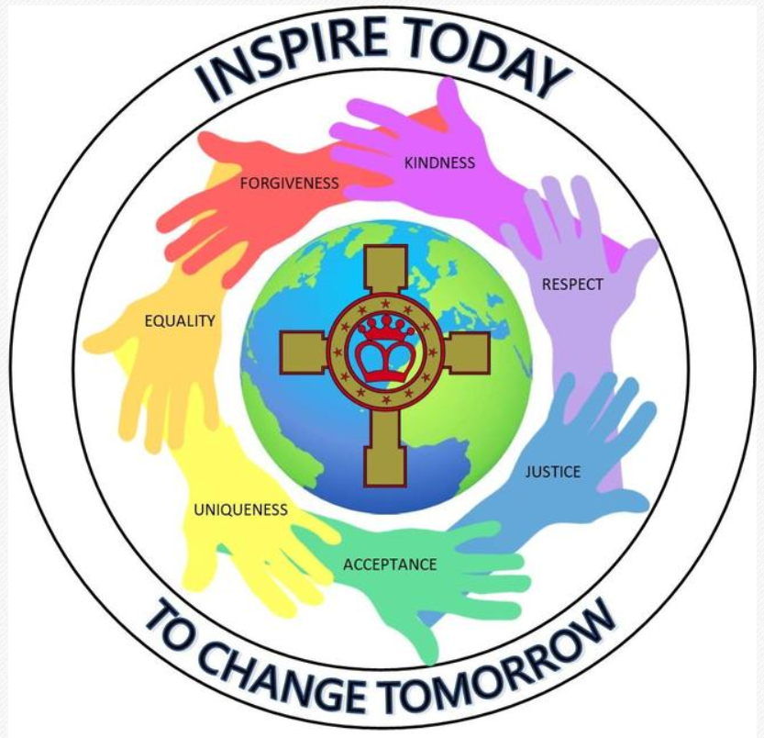
Year 5 – Geography Autumn Term
Topic: A sense of place Fertile question: What is geography? Lesson sequence | Key knowledge | Key skills
1. What is geography? 2. How do we know where we are in the world? 3. Where do I live in the world? 4. What are grid references and how do we use them? 5. How do we know which direction to travel in? 6. Why are symbols used on maps? 7. Revision lesson. 8. End of unit summative assessment. | *Describe and explain what geography is and its three strands; physical, human and environmental. *Use an atlas to find, locate and plot on a map the continents, some countries and the major physical and human features in the world. * Use geographical language to accurately describe where they live in the world. *Understand and use 4 and 6 figure grid references to locate and describe where places and features are. *Understand and use the eight points of the compass to describe and locate where places and features are and how to travel between them. *Know and be able to identify a range of key OS map symbols. *Use an atlas to find, locate and plot on a map the continents, some countries and the major physical and human features in the world. * Use geographical language to accurately describe where they live in the world. *Understand and use 4 and 6 figure grid references to locate and describe where places and features are. *Understand and use the eight points of the compass to describe and locate where places and features are and how to travel between them. *Know and be able to identify a range of key OS map symbols. | *Use an atlas to find, locate and plot on a map the continents, some countries and the major physical and human features in the world. * Use geographical language to accurately describe where they live in the world. *Understand and use 4 and 6 figure grid references to locate and describe where places and features are. *Understand and use the eight points of the compass to describe and locate where places and features are and how to travel between them. *Know and be able to identify a range of key OS map symbols.

Slide 2
Year 5 – Geography Spring Term
Topic: The Amazon Rainforest Fertile question: Why is the Amazon Rainforest worth protecting? Lesson sequence | Key knowledge | Key skills
1.What are the human and physical features of South America? 2. Where are tropical rainforests located? Where is the Amazon rainforest located? 3. What is the structure of the tropical rainforest? 4. What is the climate of the Amazon rainforest? 5. How are plants and animals adapted to live in the Amazon rainforest? 6. Who are the people that live in the Amazon rainforest? 7. What is happening to the “lungs of the Earth”? 8. What does the future hold for the Amazon rainforest? 9. How can the Amazon rainforest be used more sustainably? 10. Revision and end of topic assessment | *Identify and describe the human and physical features of South America. *Describe the location of the Amazon Rainforest. *Know and be able to describe the characteristics of a tropical rainforest. *Be able to name and locate the world’s major tropical rainforests. *Describe the climate of a tropical rainforest biome and compare it to a location in the UK. *Describe the structure of a tropical rainforest and be able to name the four layers and describe their characteristics. *Describe the characteristics and explain the importance of the Amazon Rainforest and Amazon River. *Name animals and plants that live in the Amazon rainforest and describe and explain how they are adapted to survive there. *Know some of the indigenous tribes who live in the rainforest, be able to compare and contrast their way of living with ours. Describe and explain the threats and challenges they face. *Describe and explain how the rainforest is used as a resource at different scales – locally, nationally and globally. *Describe and explain the threats and challenges the tropical rainforests face in the 21st century. *Through geographical enquiry, debate and consider how the tropical rainforests can be used more sustainably. | * Use maps, atlases, globes and digital/computer mapping to locate countries and describe features studied. * Use of aerial and satellite photographs. * Use Geographical Information Systems (GIS) to view, analyse and interpret places and data. *Select and construct appropriate graphs and charts to present data, using appropriate scales. *Plot information on graphs when axes and scales are provided. *Interpret and extract information from different types of maps, graphs and charts. *Demonstrate the ability to: identify questions and sequences of enquiry write descriptively, analytically and critically communicate their ideas effectively. *Develop thinking like a geographer skills - be able to communicate information in ways suitable for a range of target audiences.

Slide 3
Year 5 – Geography Summer Term
Topic: Mountains Fertile question: Is tourism sustainable in the mountains? Lesson sequence | Key knowledge | Key skills
What are mountains? Where are the major mountain ranges and where are they located? What are the features of a mountain? How are mountains formed? What is the climate of a mountain biome? How are plants and animals adapted to live in a mountain biome? How are humans using mountains environments? What are the threats and challenges to mountain environments? Is tourism sustainable in the mountains? 10. Revision and end of topic assessment | *Name and be able to locate the world’s major mountains and mountains ranges. *Know and be able to identify the major features of a mountain and mountain environments. *Describe and explain the processes of how mountains are formed. *Describe the climate of a mountain environment/biome and compare it to a location in the UK. *Name animals and plants that live in mountain environments and describe and explain how they are adapted to survive there. *Describe and explain how humans are using mountain environments and how land use has changed over time. *Describe and explain the threats and challenges mountain environments face in the 21st century. *Through geographical enquiry, debate and consider if mountain environments can support tourism sustainably in the 21st century. | * Use maps, atlases, globes and digital/computer mapping to locate countries and describe features studied. * Use of aerial and satellite photographs. * Use Geographical Information Systems (GIS) to view, analyse and interpret places and data. *Select and construct appropriate graphs and charts to present data, using appropriate scales. *Plot information on graphs when axes and scales are provided. *Interpret and extract information from different types of maps, graphs and charts. *Demonstrate the ability to: identify questions and sequences of enquiry write descriptively, analytically and critically communicate their ideas effectively. *Develop thinking like a geographer skills - be able to communicate information in ways suitable for a range of target audiences.

