Slide 1
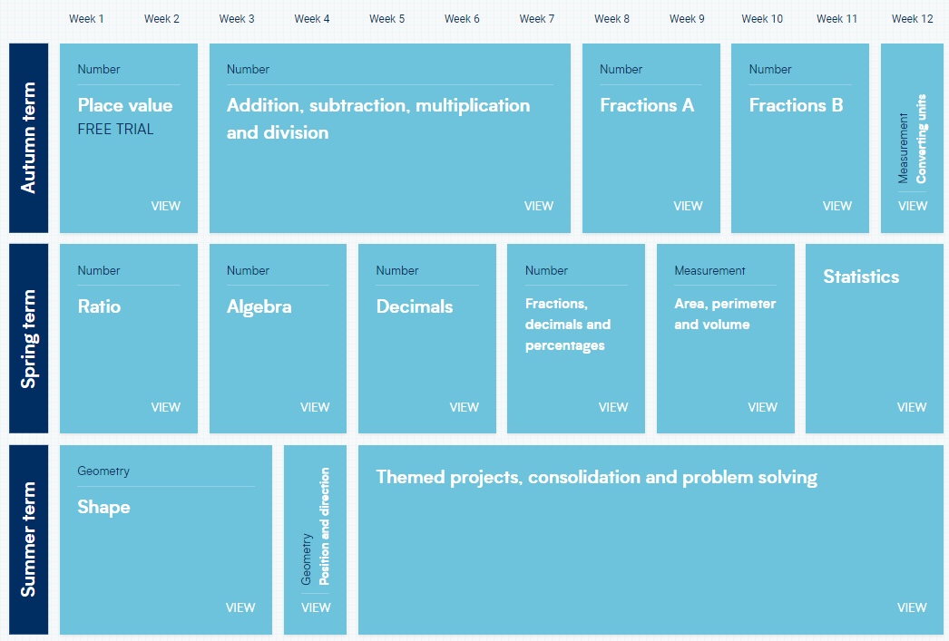
Y7 25-26
This scheme of learning is a transition from White Rose V2 units and WR V3 units as these are released . To address the attainment gaps it will be supplemented with work on KS2 key skills and materials from the NCETM, Checkpoints and Securing Foundations at Y7 intervention Decks 1-6
Unit 1: Properties of Number
Access test 1A
Unit 1&2 : Calculating with directed numbers
Unit 4: Geometry and Measures
Properties of Number
Rounding and Estimating
Place Value, Ordering and Rounding
Directed Numbers
Four Operations
Angles and Polygons
Unit 2: Calculating with FDP
NCETM Decks 3&4 Multiplicative Reasoning Access test 1B
Unit 4:Geometry and Measures
Fractions and Percentages of Amounts
Four operations
Fractions, Decimals, Percentages.
Add and subtract fractions
Perimeter and Area
Unit 3: Algebra
NCETM Securing Foundations Deck 5 Fractional thinking
Unit 5: Statistics inc probability Unit 4
NCETM Decks 5&6
Access test 2a
Sequences
Algebraic notation and Substitution
Expressions and Equations
Introduction to Probability
WR 7 V2
Graphing
data
Averages and Range
Speed,
Distance,
Time

Slide 2
Y8 White Rose Version 3.
Intervention 25-26
To reduce the attainment gap this is supplemented with work on KS2 key skills and Unit 5&6 from the NCETM Checkpoints and Securing Foundations at Y7 programme.
Unit 1: Mastery of Number Access Test 2B Unit 3 Algebra
Unit 2a: Calculating with Fractions
Revision and consolidation
Standard Form
Indices
Percentages
Multiply and Divide Fractions
Unit 2b: Proportional Reasoning
Ratio, Proportion and rates of change
Unit 4 : Geometry and Measures
Access Test 3A
Ratio
Proportion and Scale
Angles in Parallel lines and Polygons
Circles
Symmetry and Reflection
Unit 3: Algebra
Unit 5: Statistics and probability
Access Test 3B
Algebraic Manipulation
Equations and Inequalities
Coordinates and Graphs
Sequences
Tables and Probability
Graphs and Charts
Interpret and Represent Data

