Slide 1
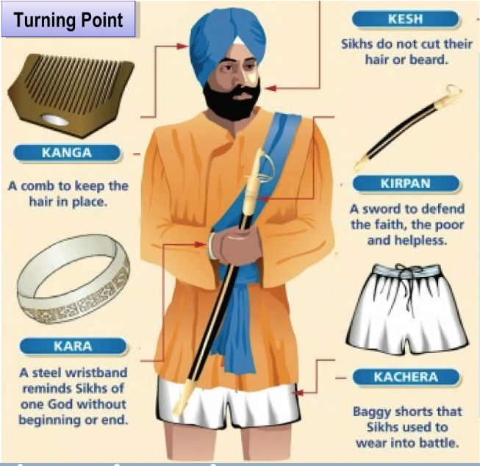
Yr 5 How do Sikhs show their commitment to God?
Sikhism is a monotheistic religion (belief in one god) that originated in India in the Punjab region. It is one of the youngest of the major religions having began around the end of the 15th Century and is the fifth largest organised religion in the world.
Guru
The term Guru comes from the Sanskrit guru, meaning teaching, guide or mentor. The traditions and philosophy of Sikhism were established by ten Gurus from 1469 to 1708. Each Guru added to and reinforced the message taught by the previous, resulting in the creation of the Sikh religion. Guru Nanak was the first Guru and appointed a disciple as a successor. Guru Gobind Singh was the final Guru in human form. Before his death, he decreed that the Guru Granth Sahib would be the final and perpetual Guru of the Sikhs.
Guru Nanak
Founded - 1539
Guru Angad
1539-1552
Guru Amar Das
1552-1574
Guru Ram Das
1574-1581
Guru Arjan
1581-1606
Guru Har Gobind
1606-1644
Guru Har Rai
1644-1661
Guru Har Krishan
1661-1664
Guru Tegh Bahadur
1665-1675
Guru Gobind Singh
1675-1708
Guru Granth Sahib
1708 - onwards
The Five Ks are five items that Guru Gobind Singh commanded Khalsa Sikhs to wear at all times. These aren’t just symbols but are articles of faith.
Key Terms
Uncut long hair and beard that shows a sign of spiritual devotion as well as a respect for the perfection of God’s creation.
Khanda - This is the symbol of the Sikh faith.
A small wooden comb used twice a day that is worn in the hair at all times and covered by a turban.
Guru Granth Sahib - The Guru Granth Sahib is the holy scripture for Sikhs and is regarded as the living Guru.
A dagger or sword which symbolises a Sikh’s duty to come to the defence of others in peril.
An iron bracelet that is circular to symbolise that God is never ending.
Gurdwara - A place of assembly and worship for Sikhs. People from all faiths are welcome.
Khalsa - To be pure, clear and free from. It formulates an initiation ceremony and rules of conduct for Khalsa warriors. Upon initiation, male Khalsa Sikhs are given the title Singh and females Kaur.
A shalwar-undergarment with a tie knot worn by baptised Sikhs. They must not come below the knee and were originally made as part of a Sikh soldier's uniform.

